Slide 1
Scenario Comparison
France-Belgium Border
Department 64 France

Slide 2
Study Area
Department 64
France-Belgium border
Habitat | Number of cells
Type 1 | 865
Type 2 | 86
Type 3 | 21
TOTAL | 972
Habitat | Number of Cells
Type 1 | 902
Type 2 | 400
Type 3 | 81
TOTAL | 1 383

Slide 3
Population

Slide 4
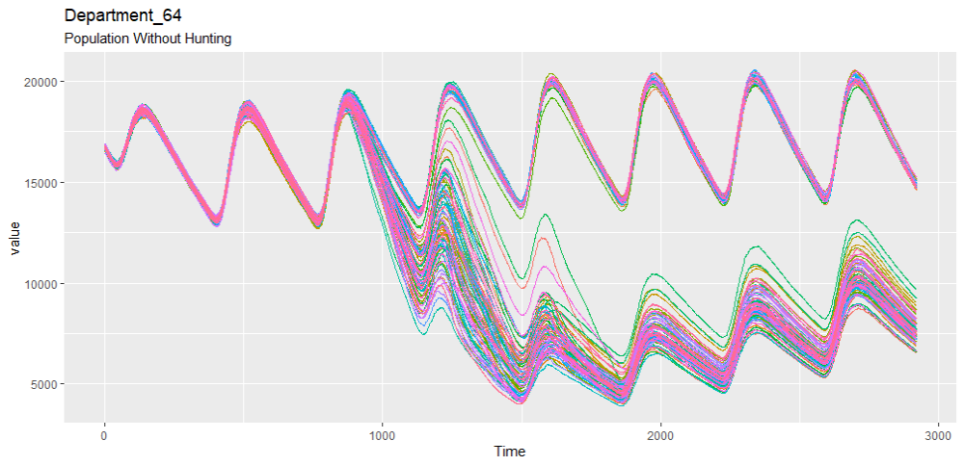
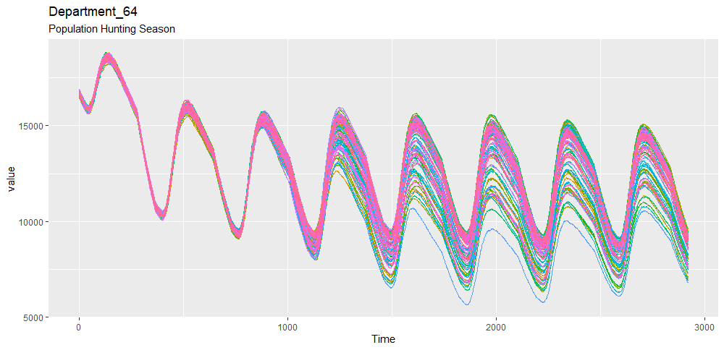

Slide 5
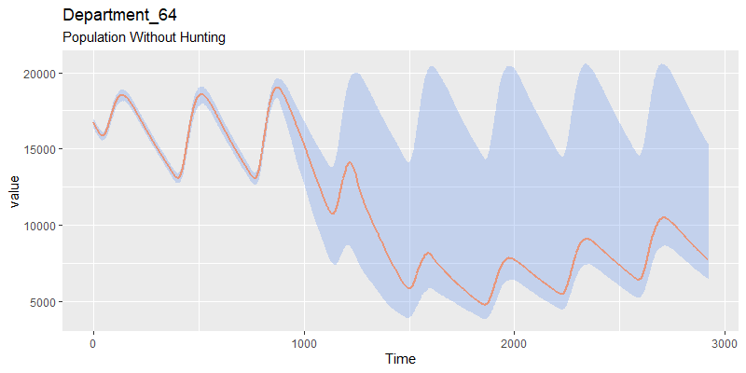
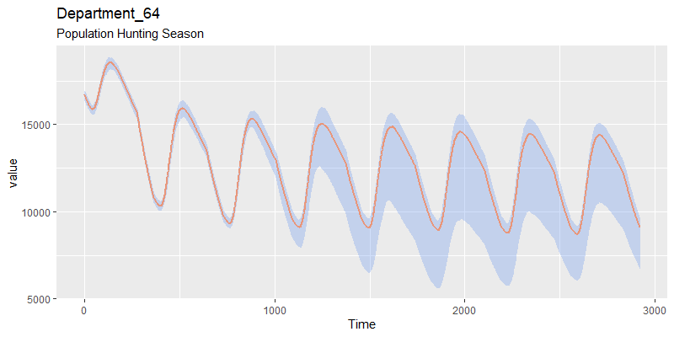

Slide 6
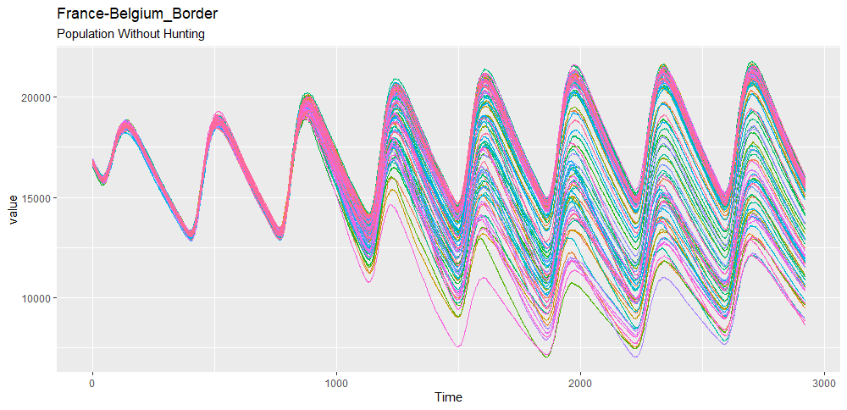
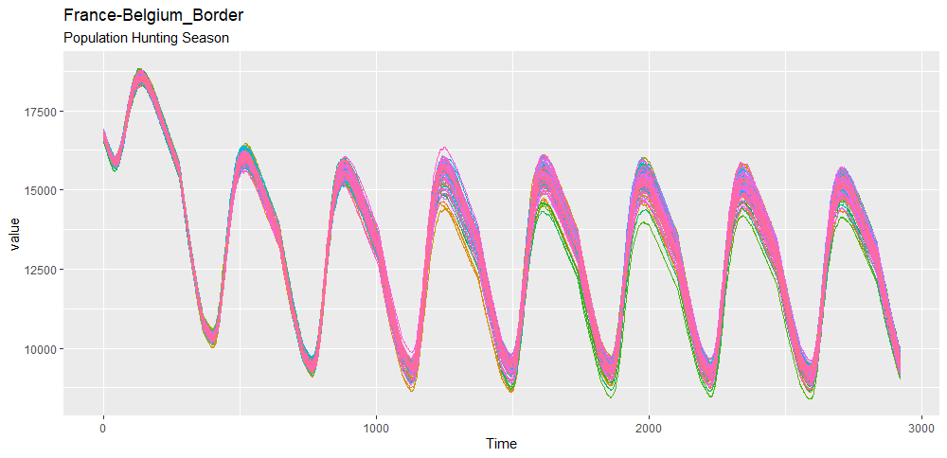

Slide 7
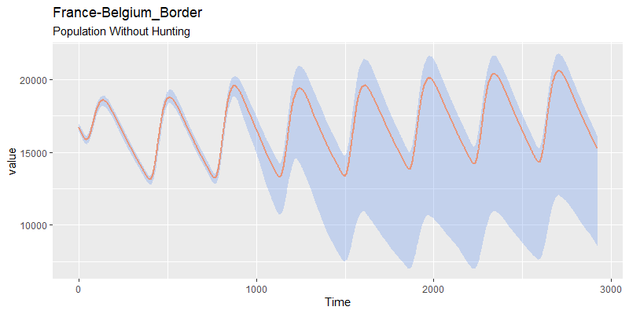
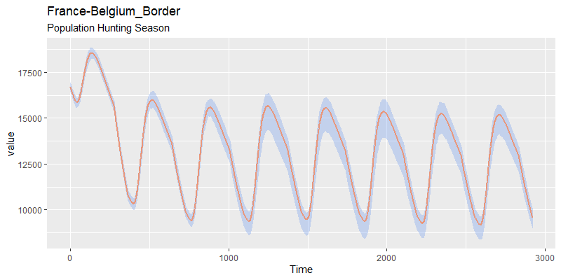

Slide 8
Density
Wild boar/ km square

Slide 9
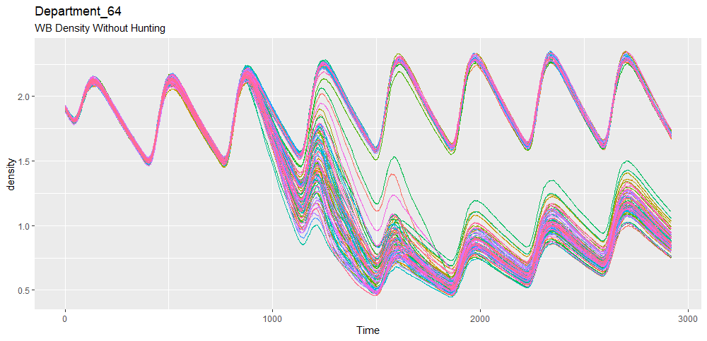
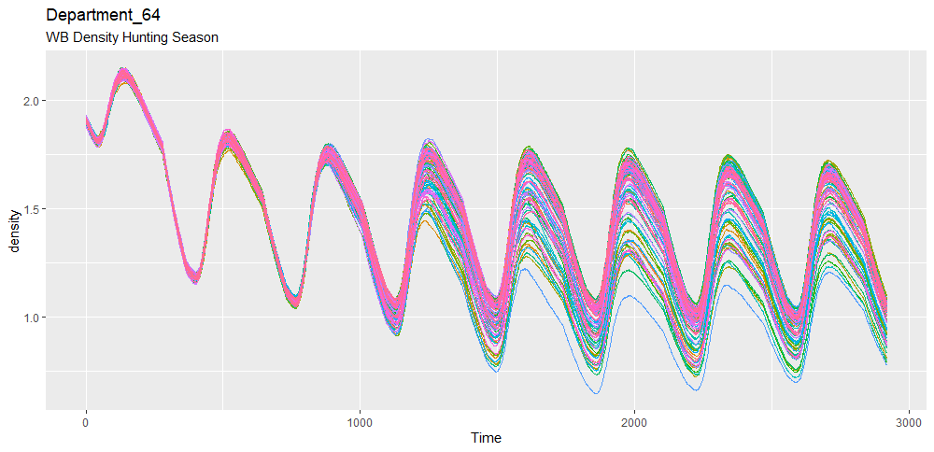

Slide 10
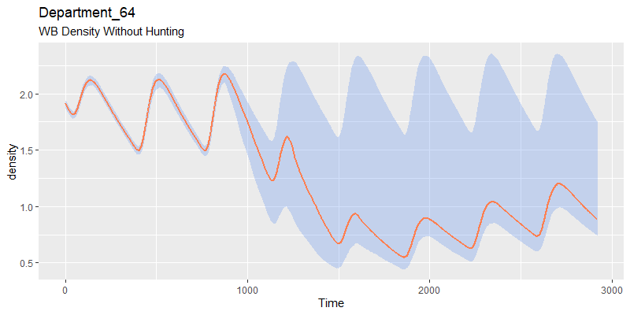
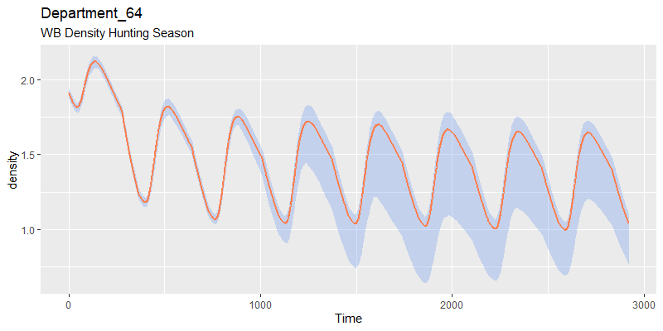

Slide 11
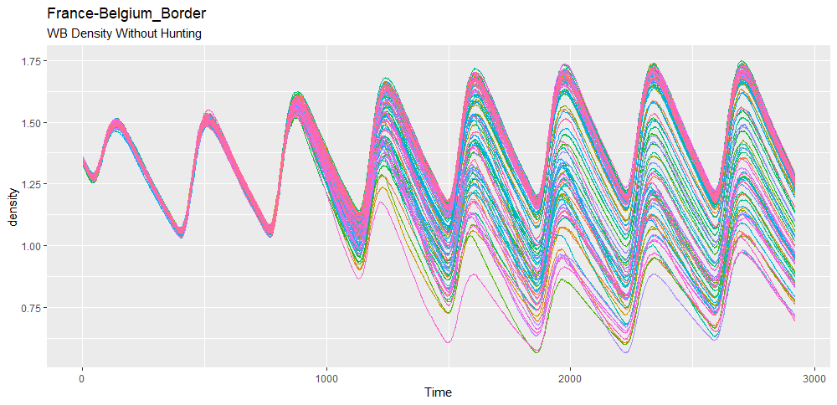
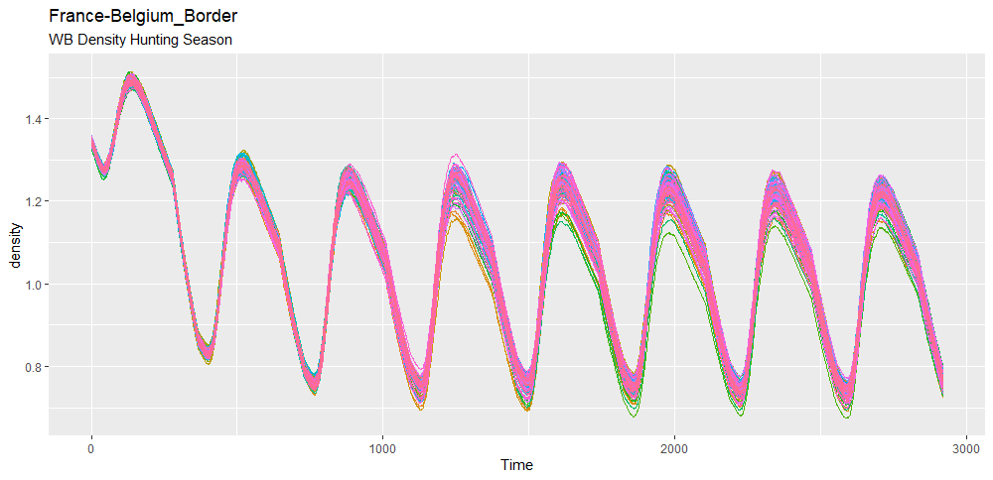

Slide 12
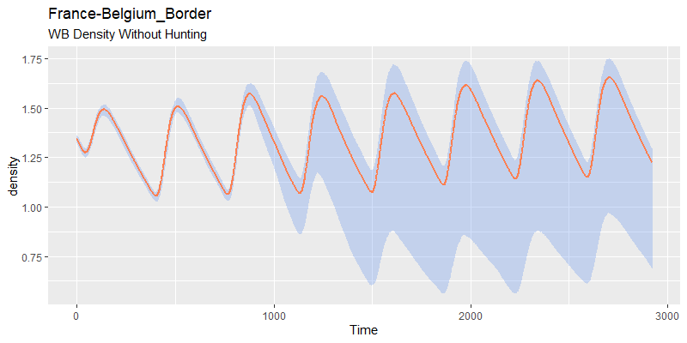
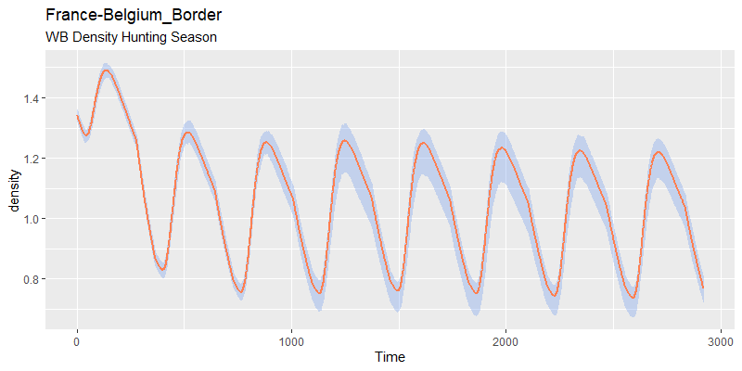

Slide 13
Incidence

Slide 14
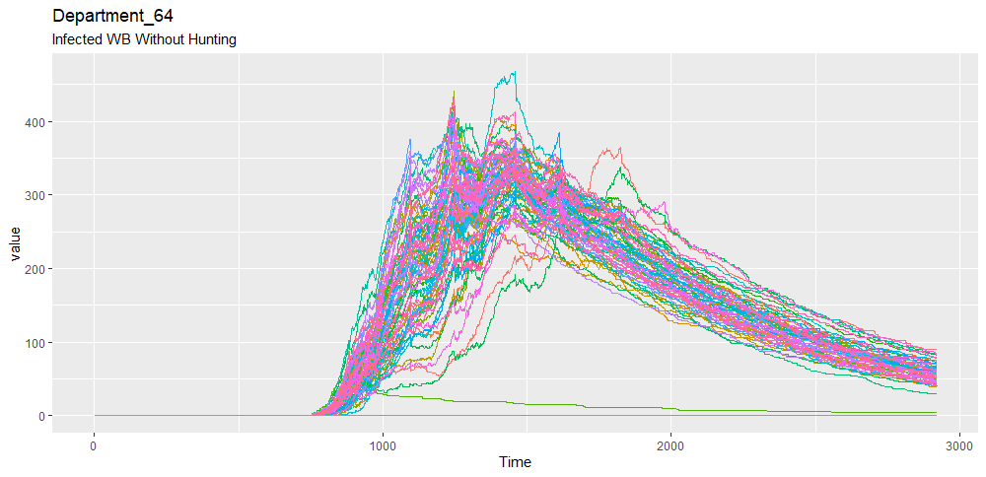
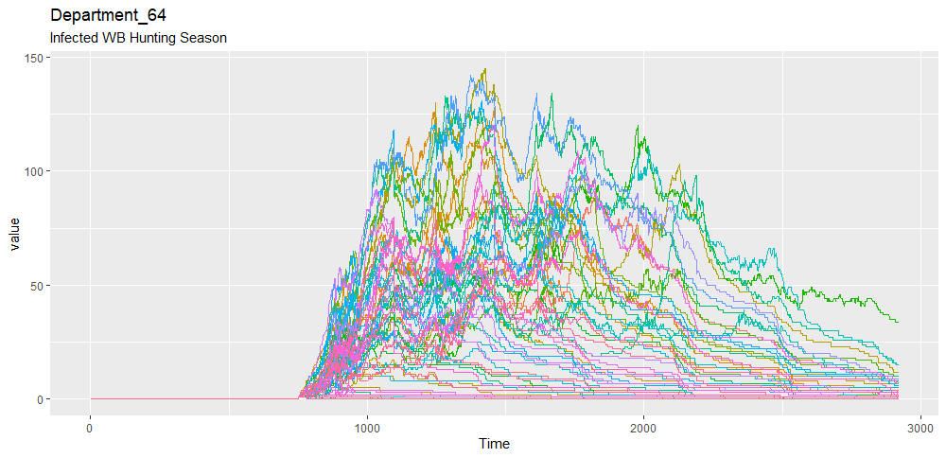

Slide 15
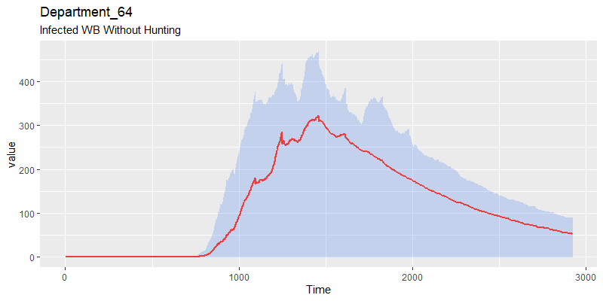
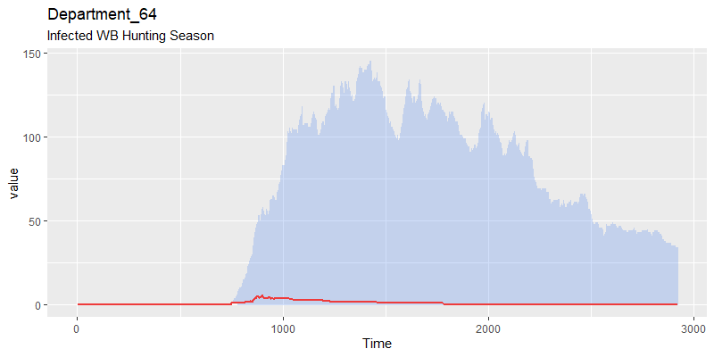

Slide 16
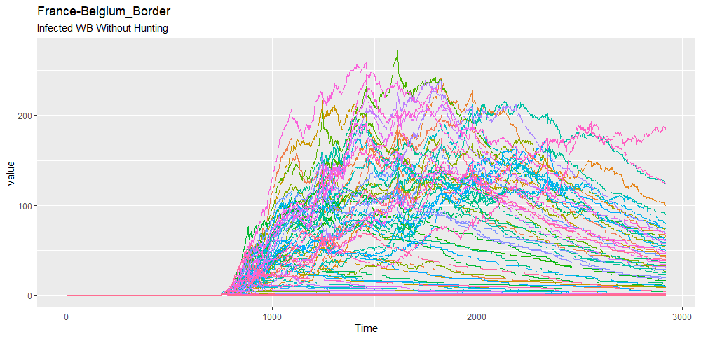
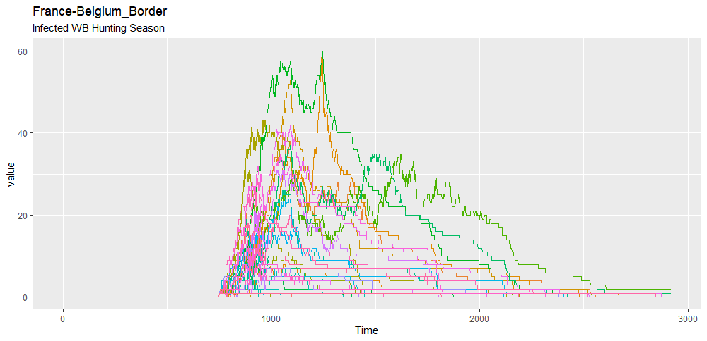

Slide 17
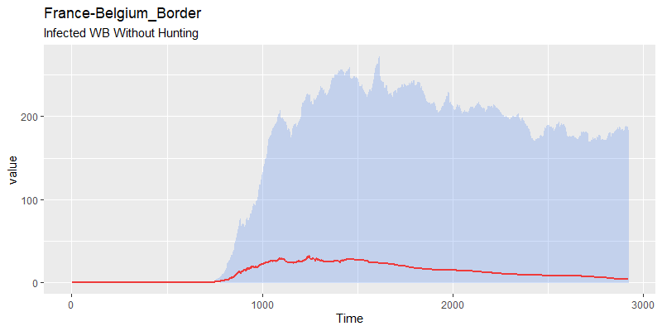
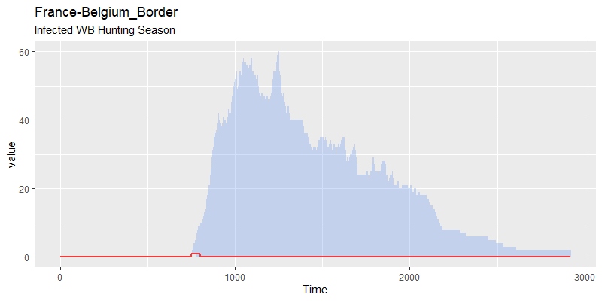

Slide 18
Carcasses

Slide 19
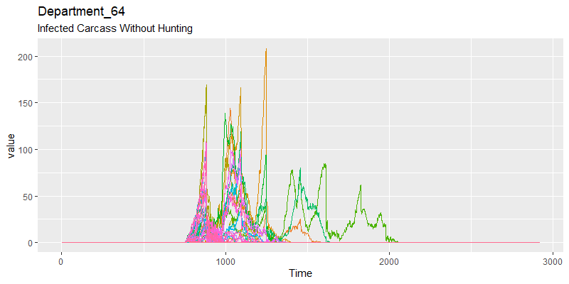
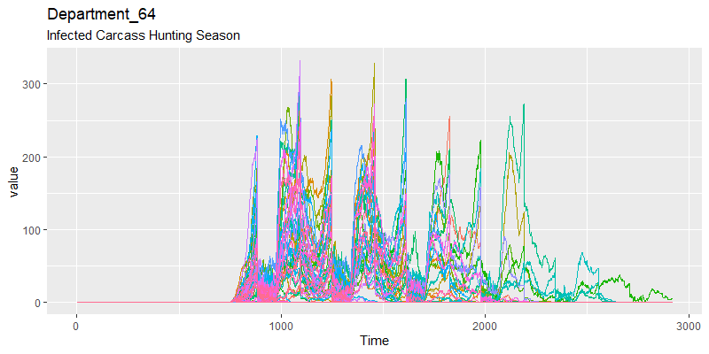

Slide 20
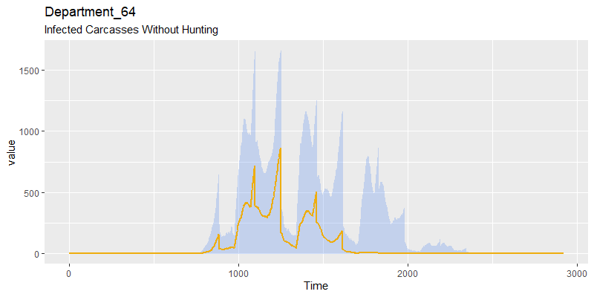
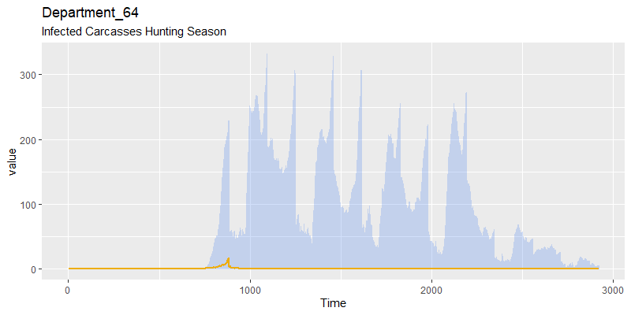

Slide 21
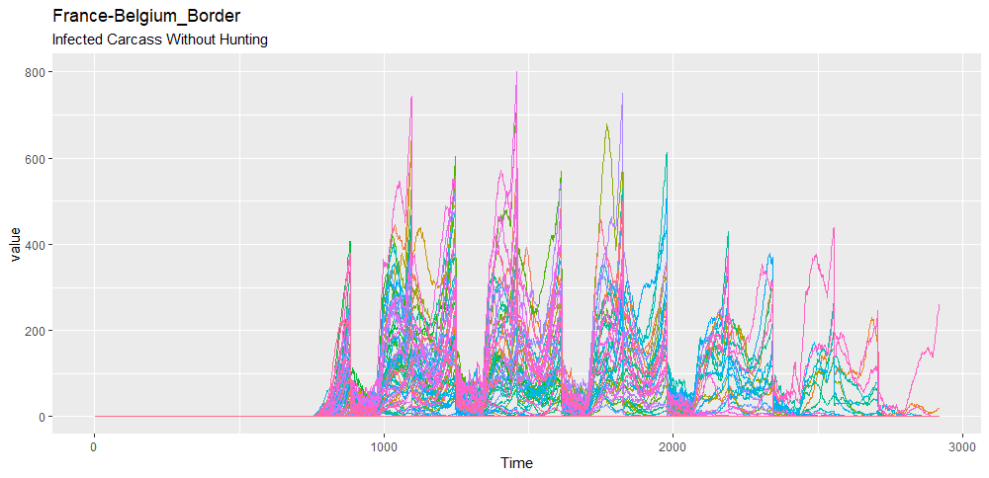
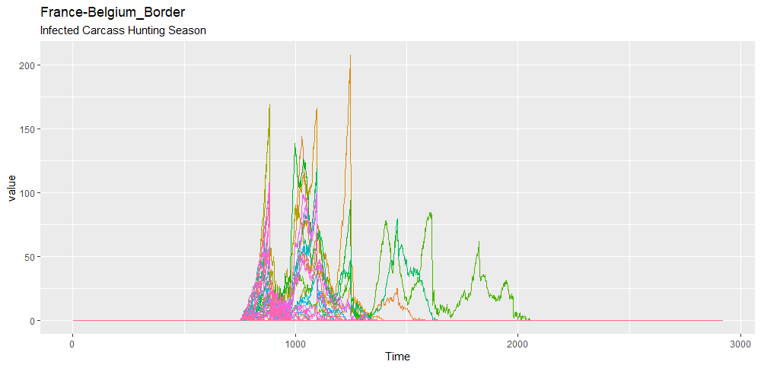

Slide 22
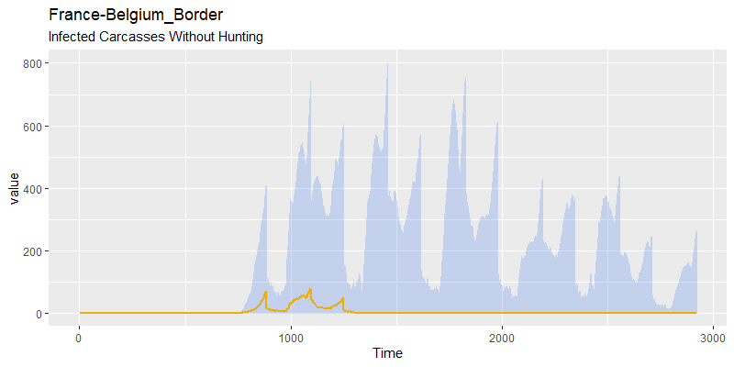
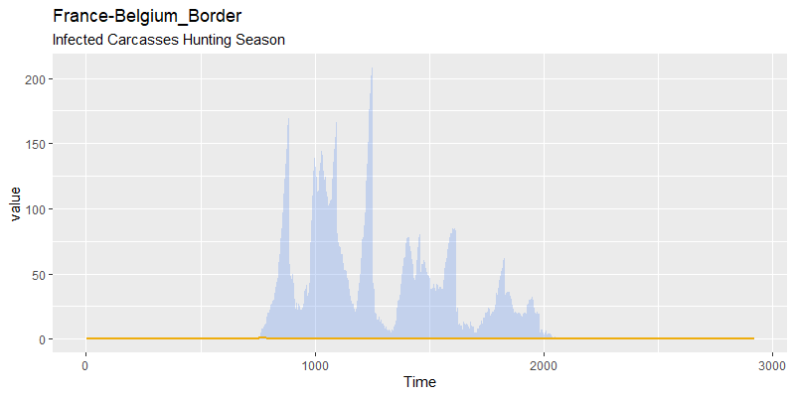

Slide 23
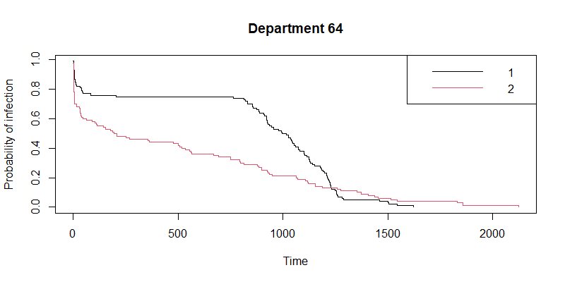
Department 64 – Scenarios Comparisons
Without Hunting
Hunting Season

Slide 24
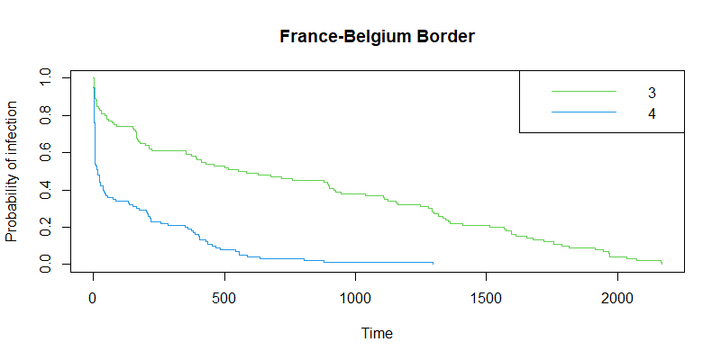
France-Belgium – Scenarios Comparisons
Without Hunting
Hunting Season

Slide 25
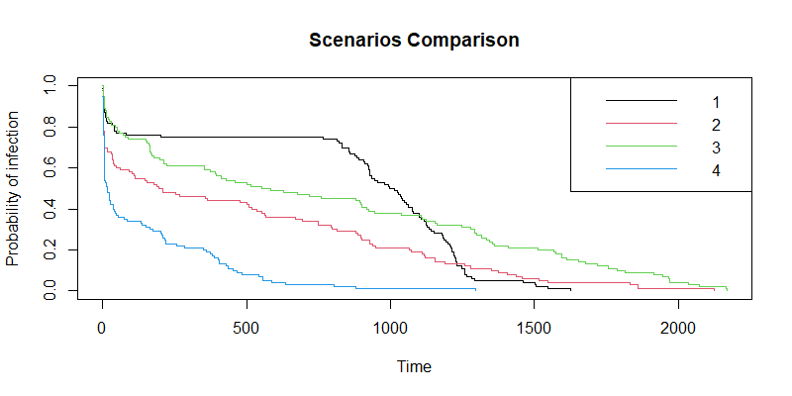
Dep 64 No Hunting
Dep 64 Hunting S
Fr-Bel No Hunting
Fr-Bel Hunting S

Slide 26
ASF Introduction in Summer
Department 64
France-Belgium border
Habitat | Number of cells
Type 1 | 865
Type 2 | 86
Type 3 | 21
TOTAL | 972
Habitat | Number of Cells
Type 1 | 902
Type 2 | 400
Type 3 | 81
TOTAL | 1 383
Day 900
2nd year
June

Slide 27
Population
Summer vs Winter Introduction

Slide 28
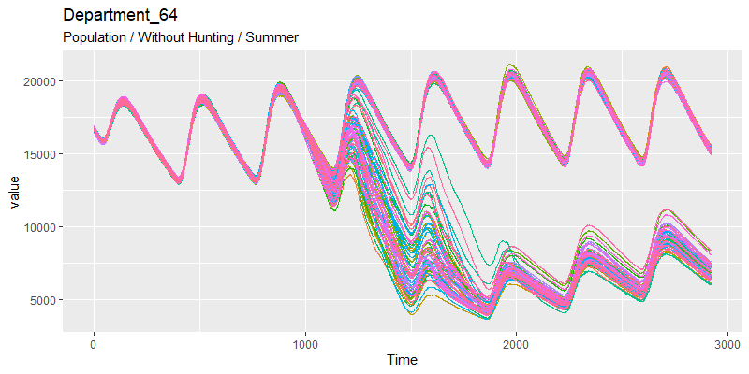
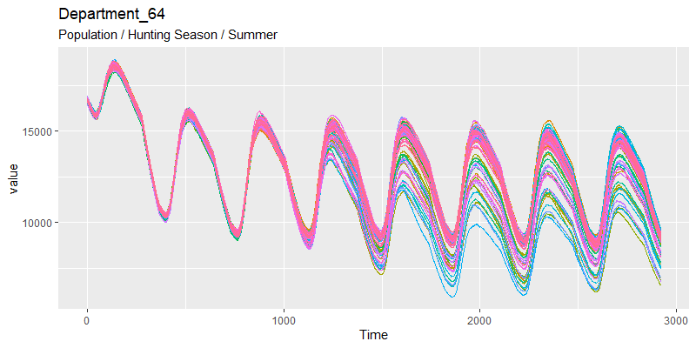

Slide 29
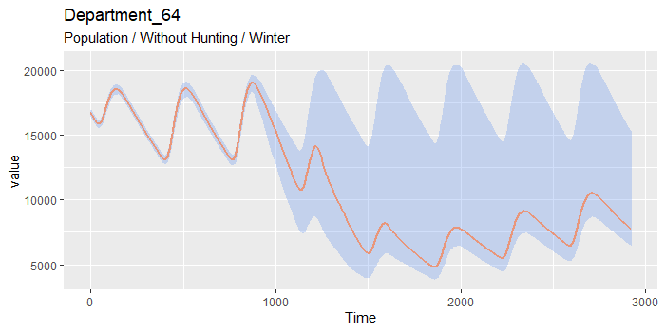
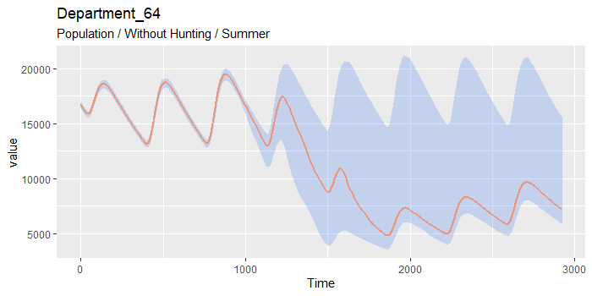
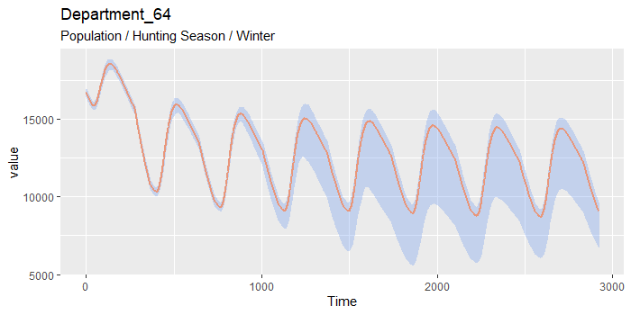
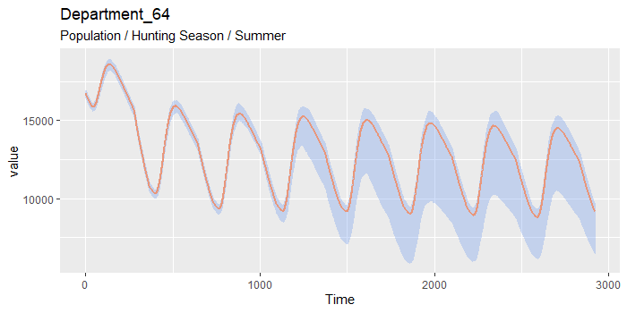
Winter Introduction
Summer Introduction

Slide 30
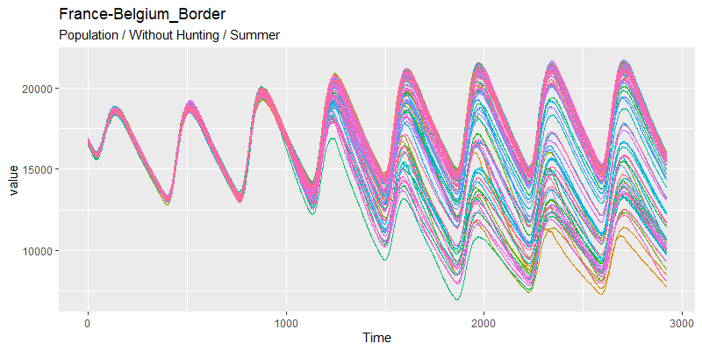
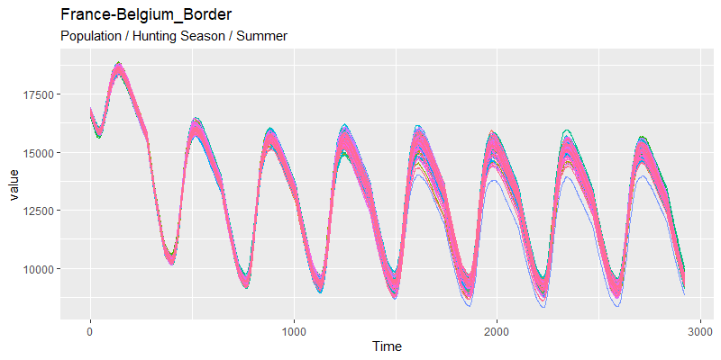

Slide 31
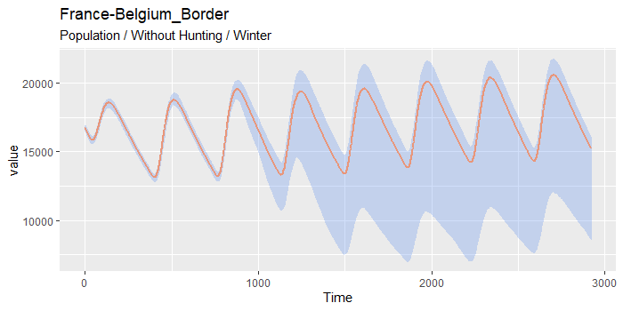
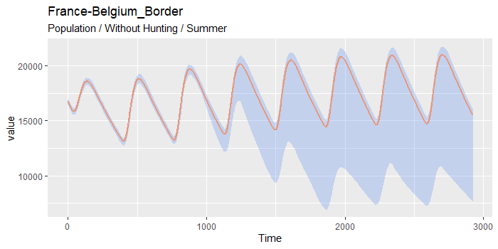
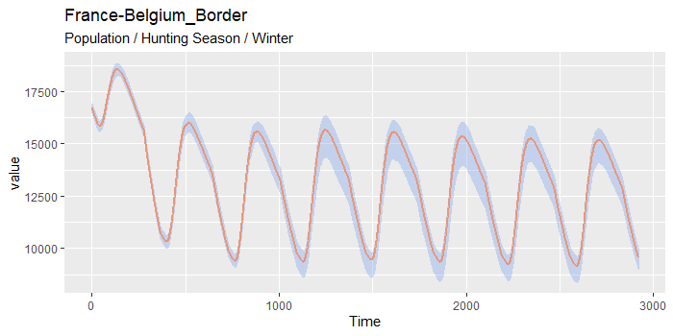

Winter Introduction
Summer Introduction

Slide 32
Density
Summer vs Winter Introduction

Slide 33
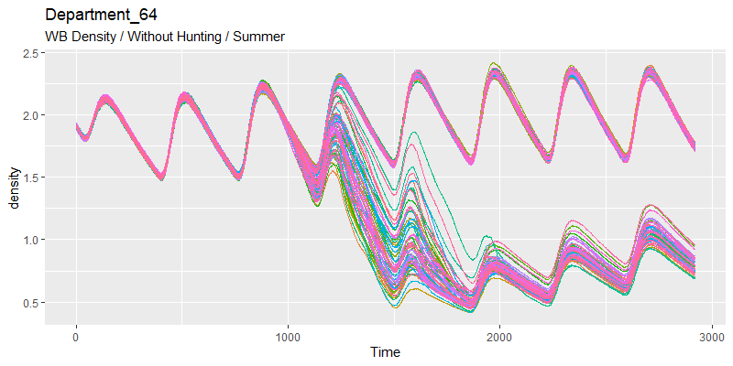
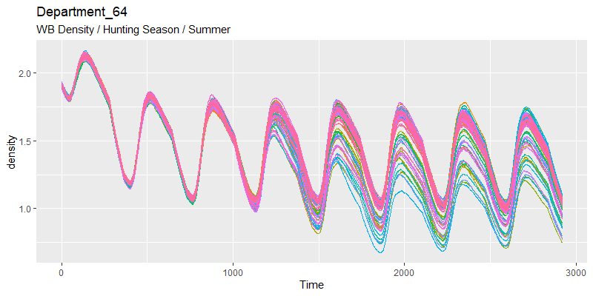

Slide 34
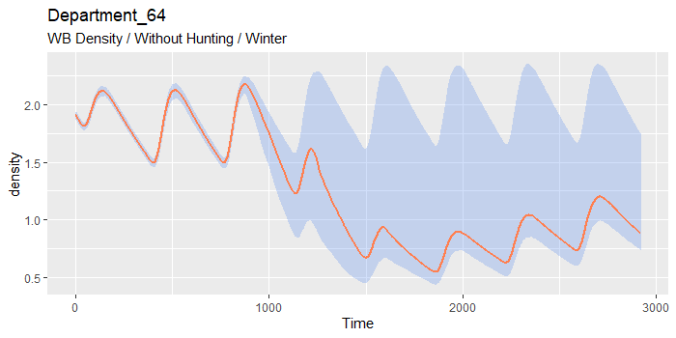
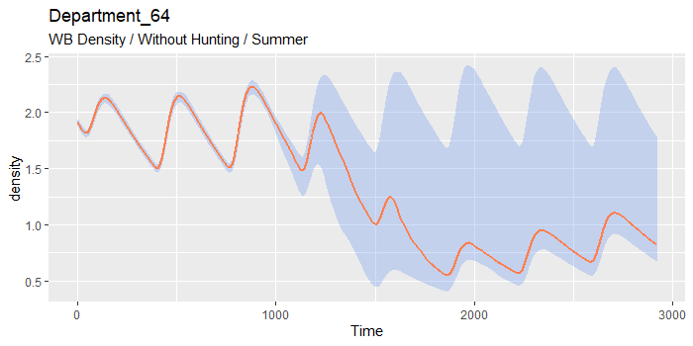


Winter Introduction
Summer Introduction

Slide 35



Slide 36




Winter Introduction
Summer Introduction

Slide 37
Incidence
Summer vs Winter Introduction

Slide 38



Slide 39




Winter Introduction
Summer Introduction

Slide 40



Slide 41




Winter Introduction
Summer Introduction

Slide 42
Carcasses
Summer vs Winter Introduction

Slide 43



Slide 44




Winter Introduction
Summer Introduction

Slide 45



Slide 46




Winter Introduction
Summer Introduction

Slide 47

Department 64 – Scenarios Comparisons
Without Hunting
Hunting Season

Slide 48

France-Belgium – Scenarios Comparisons
Without Hunting
Hunting Season

Slide 49

Dep 64 No Hunting
Dep 64 Hunting S
Fr-Bel No Hunting
Fr-Bel Hunting S

Slide 50

Dep 64 No Hunting Winter
Dep 64 Hunting Winter
Fr-Bel No Hunting Winter
Fr-Bel Hunting Winter
Dep 64 No Hunting Summer
Dep 64 Hunting Summer
Fr-Bel No Hunting Summer
Fr-Bel Hunting Summer

